Slide 1

Dissertation
Saikat Adhikary
21EX40019
Topic: Estimation of Porosity Using bayesian techniques for given well log data (sonic and Density)

Slide 2





Topic :joint Estimation of Porosity Using Bayesian inference

Slide 3

Main Goal
To Predict/Estimate the Porosity using Given Sonic and Density Data using Bayesian Method.
The input features are Δtp,Δts and density(rho) ,and output feature is Sonic porosity

Slide 4

Why Bayesian inference ?
The algorithm works on simple Probability Model thus it Can Handle Bulk Data with less amount of Time
When Data follows Gaussian Distribution , then This Gives good accuracy.
When an assumption of independent predictors holds true, a this classifier performs better as compared to other models

Slide 5

workflow
Choose suitable Feature for modelling
Loading Data
Data Cleaning
Final Model
Other Prepossing Steps
Feature Transformation
Test The Performance of The Model

Slide 6


Loading data
The data file for well log are generally in .las file format ,we use python pandas for reading data and for further processing

Slide 7
The Primary Assumption For The Model is That The Features are Independent ,so We have to Choose such feature That are independent with each other, i.e, coefficient of correlation is Zero;
Feature Transformation :the Primary assumption for The model is our attribute follows Gaussian Distribution if Data will not follow gaussian Distribution ,then We Should apply transformation like:I nverse transform ,log transform, boxcox transform such that our transform Data follows Gaussian Transformation ,The Process is Useful to improve Accuracy For the Model

Slide 8

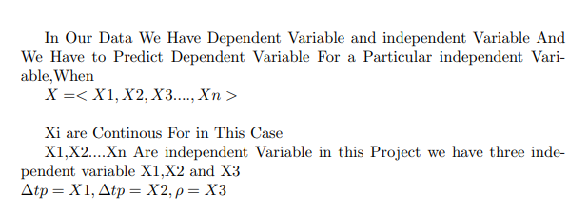

About The Algorithm

Slide 9

Data looks like:
∇ tp | ∇ts | ϼ | Porosity class

Slide 10
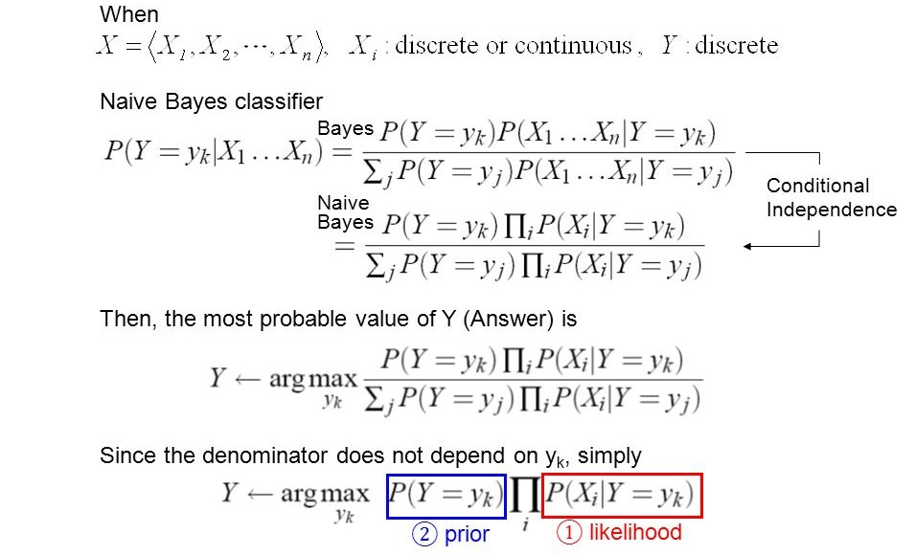
According bayesian algorithm

Slide 11

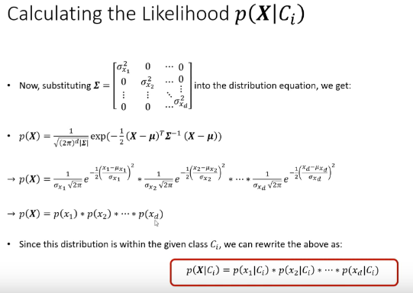
according bayes theorem

Slide 12
Result
The p(c1|X1,X2,X3) represent Probability of Getting Porosity Class 1 For Given X1=∇tp,X2=∇ts and X3=ϼ,similarly The p(c1|X1,X2,X3) represent Probability of Getting Porosity Class 2 For Given X1=∇tp,X2=∇ts and X3=ϼ;
So,the Final probability Class For Given a particular X1=∇tp,X2=∇ts and X3=ϼ is Argmax[p(c1|X1,X2,X3),p(c2|X1,X2,X3),…..,p(cn|X1,X2,X3)]

Slide 13
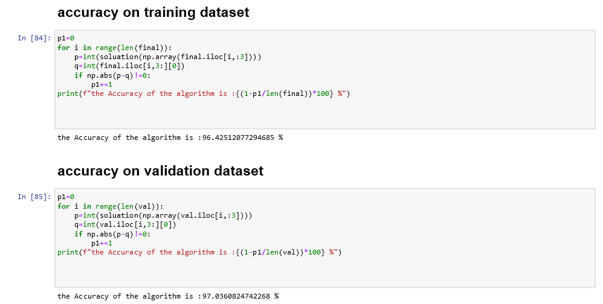
Final Result and Computation
The Computation of the above Algorithm using python gives us 96.42% and 97.03% Accuracy for Training and Validation Dataset

